Slide 1
Cost Function

Slide 2
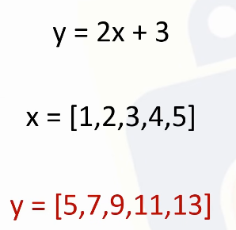
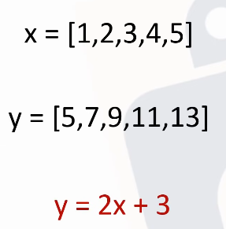

Slide 3
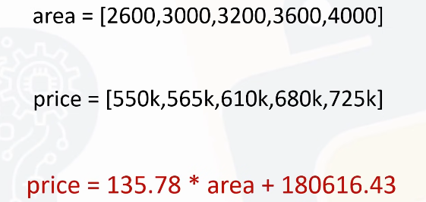

Slide 4
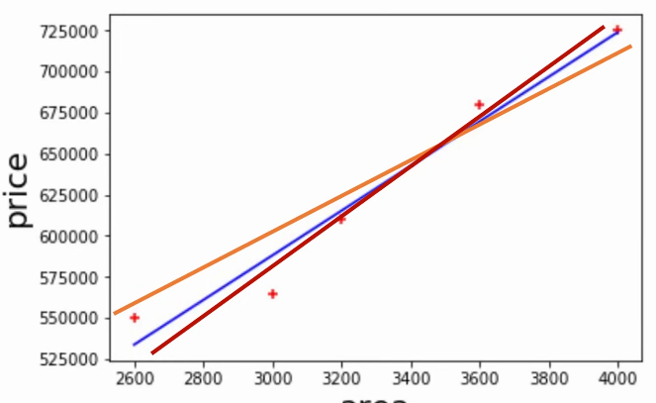

Slide 5
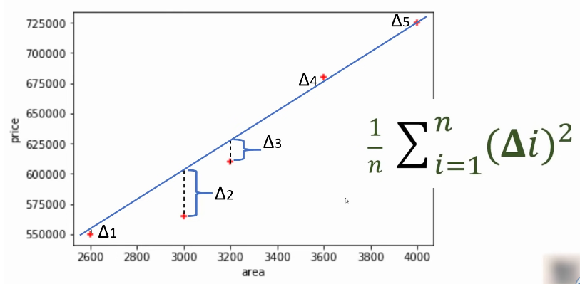

Slide 6
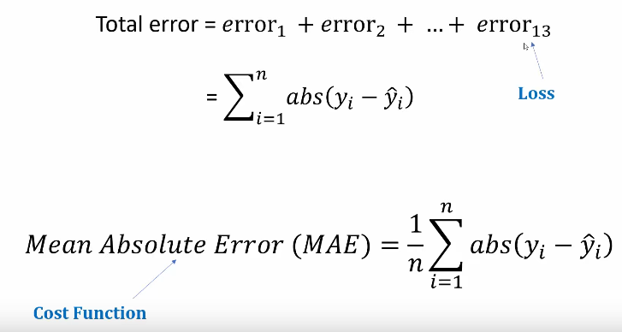
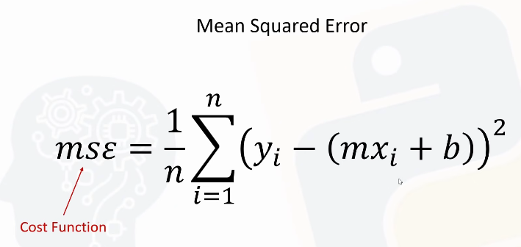

Slide 7


Slide 8
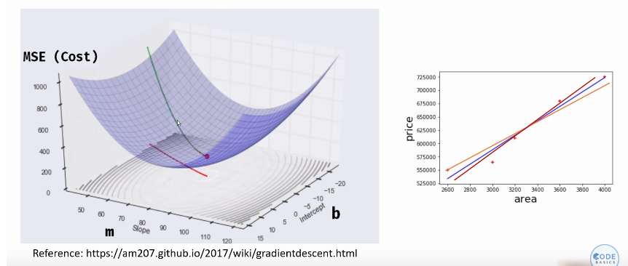

Slide 9
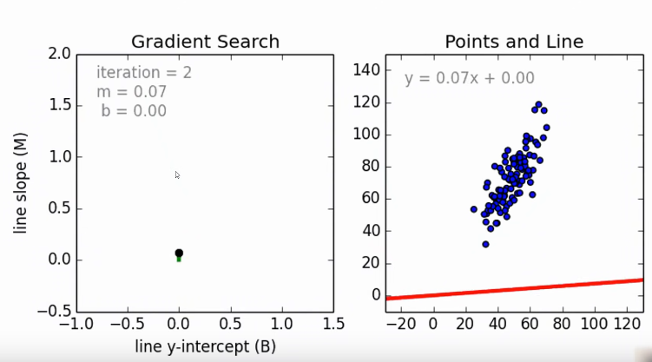

Slide 10
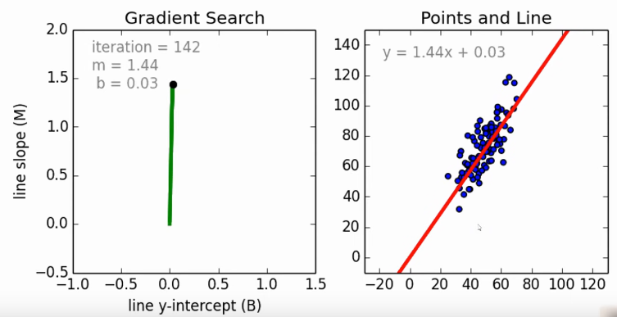

Slide 11
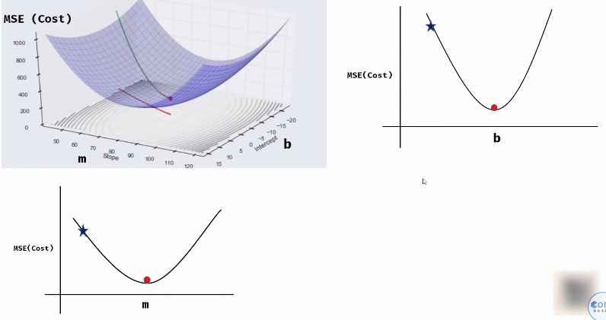

Slide 12
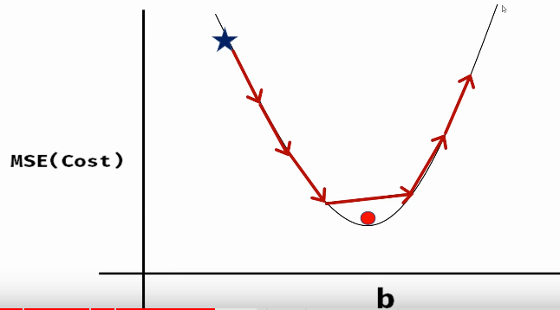
Not good approach
We can miss global minima, if we go down step wise.

Slide 13
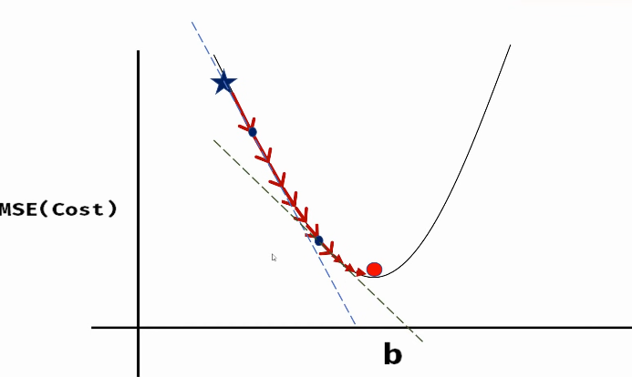
Go step wise and reduce step size as we go farther.

Slide 14
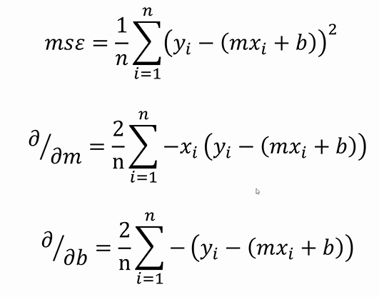

Slide 15
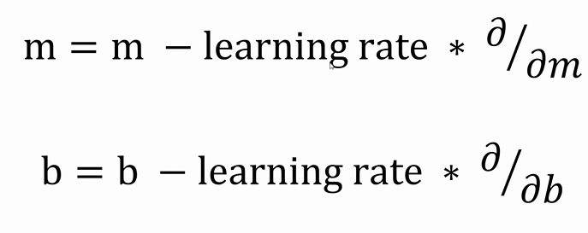

Slide 16
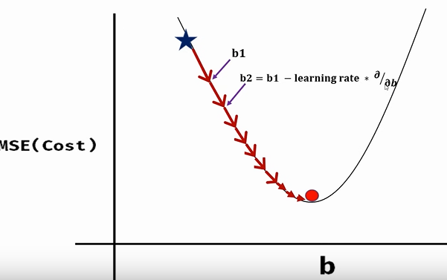

Slide 17
Reference
https://www.youtube.com/watch?v=vsWrXfO3wWw&list=PLeo1K3hjS3uvCeTYTeyfe0-rN5r8zn9rw&index=4
https://www.mathsisfun.com/calculus/derivatives-introduction.html
https://www.mathsisfun.com/calculus/derivatives-partial.html

